Slide 1
Colorado State University
Fort Collins, CO
Gas Chromatography
Fundamentals &
Cannabis Applications
Joseph DiVerdi
Department of Chemistry
Colorado State University
Fort Collins, CO USA
January 2024

Slide 2
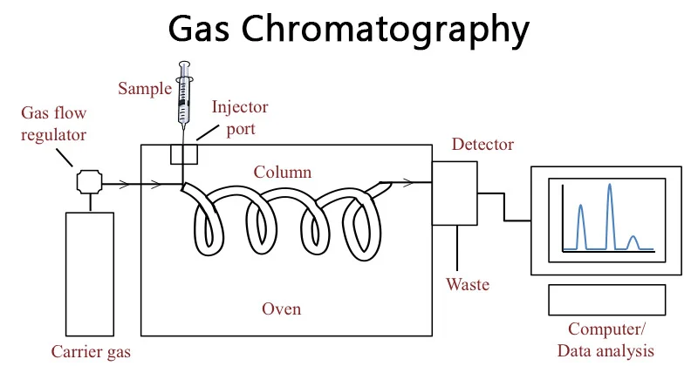
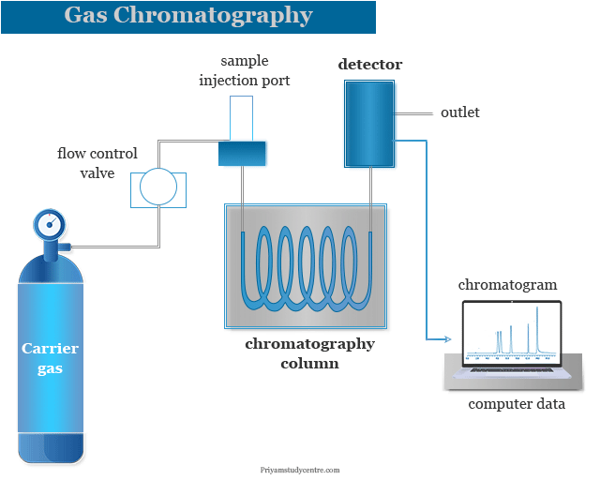
GC – Block Diagram
Colorado State University
Fort Collins, CO

Slide 3
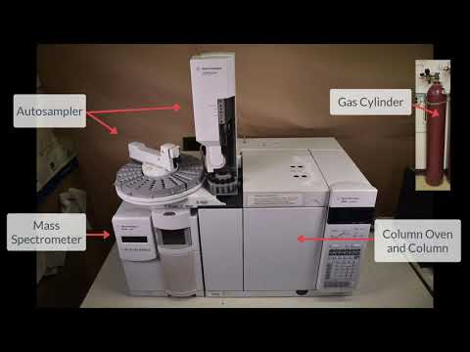
GC – Pictorial Layout
Colorado State University
Fort Collins, CO

Slide 4
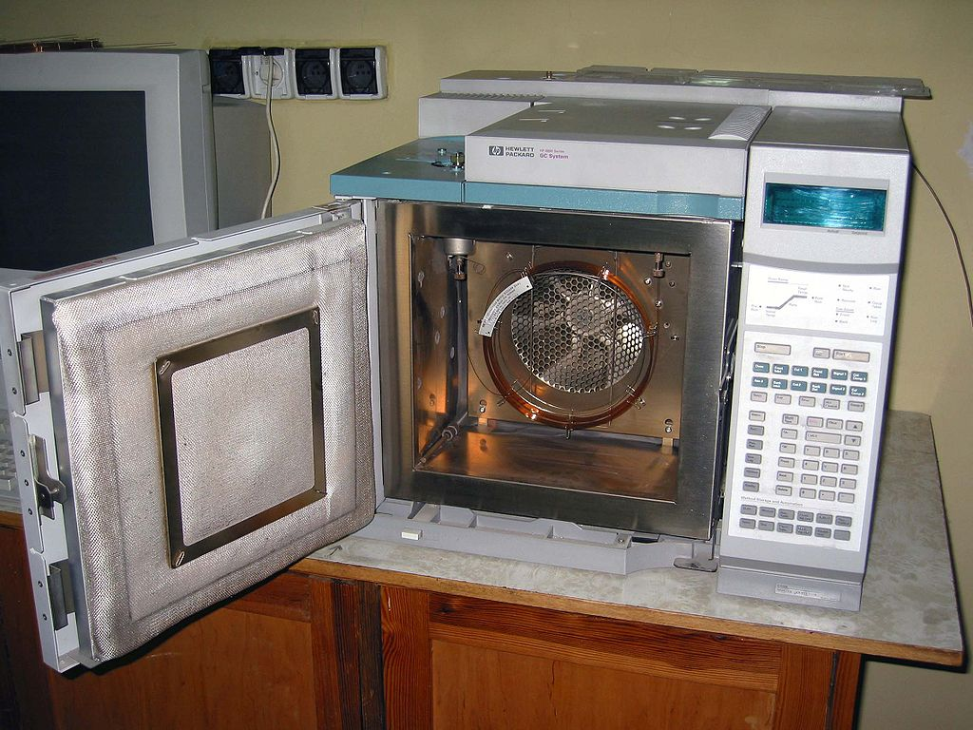
Column Oven – Where the Magic Happens
Colorado State University
Fort Collins, CO

Slide 5
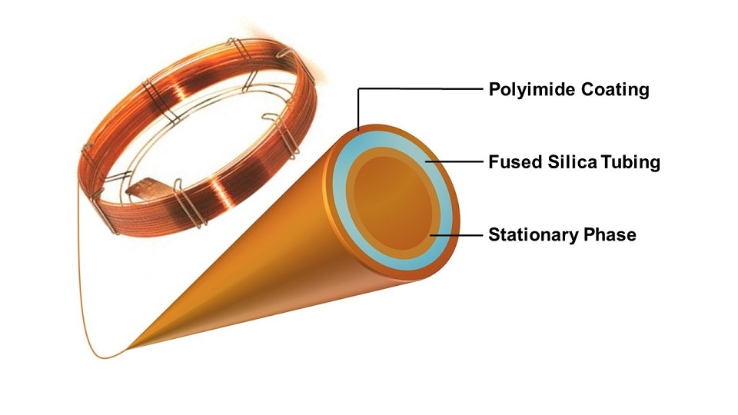
Column Overall Geometry
Colorado State University
Fort Collins, CO

Slide 6
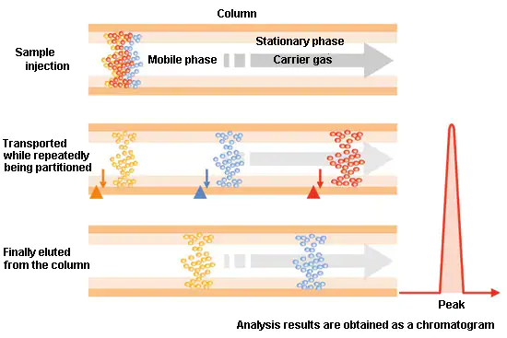
Separation Mechanism
Colorado State University
Fort Collins, CO

Slide 7
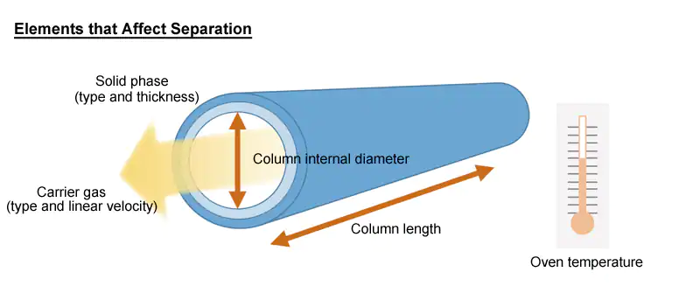
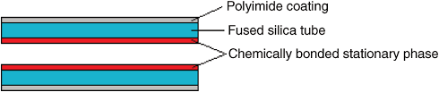
Column Internal Details
Colorado State University
Fort Collins, CO

Slide 8
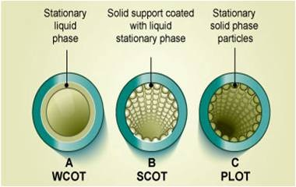
text
Colorado State University
Fort Collins, CO

Slide 9
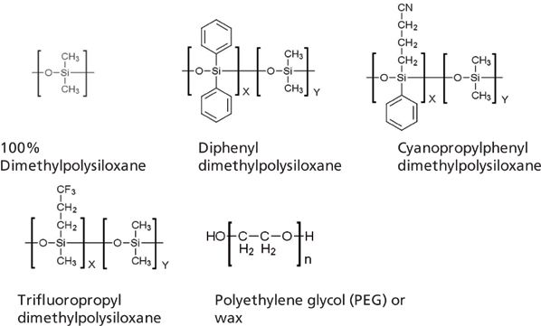
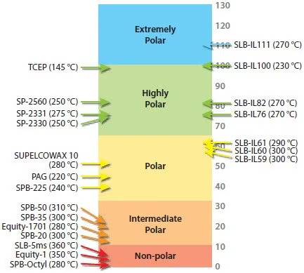
Varying Column Chemistry
Colorado State University
Fort Collins, CO

Slide 10
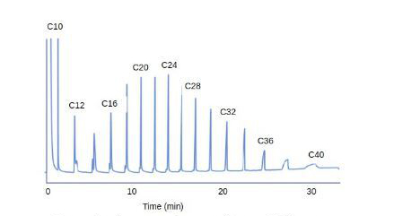
Example Chromatogram
Colorado State University
Fort Collins, CO

Slide 11
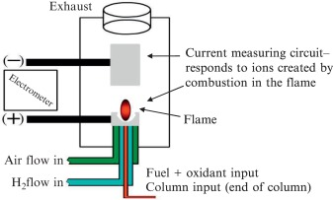
Flame Ionization Detector - FID
Colorado State University
Fort Collins, CO

Slide 12
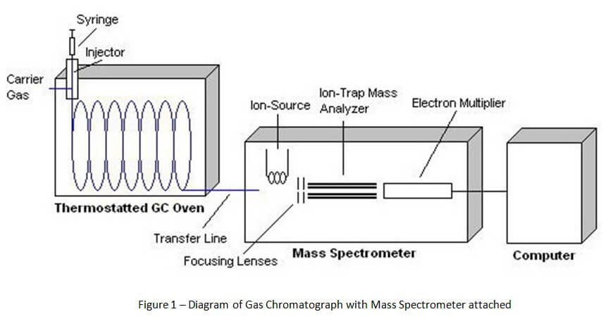
GC–MS
Colorado State University
Fort Collins, CO

Slide 13
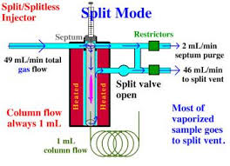
Split Mode Injection
Colorado State University
Fort Collins, CO

Slide 14
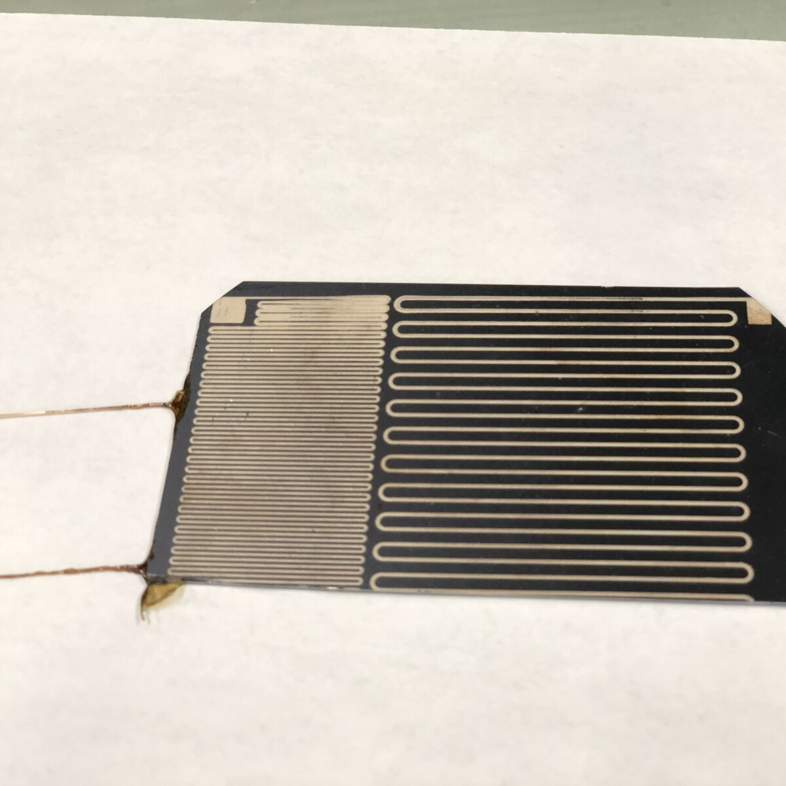
Crazy Column Configuration
Colorado State University
Fort Collins, CO

Slide 15
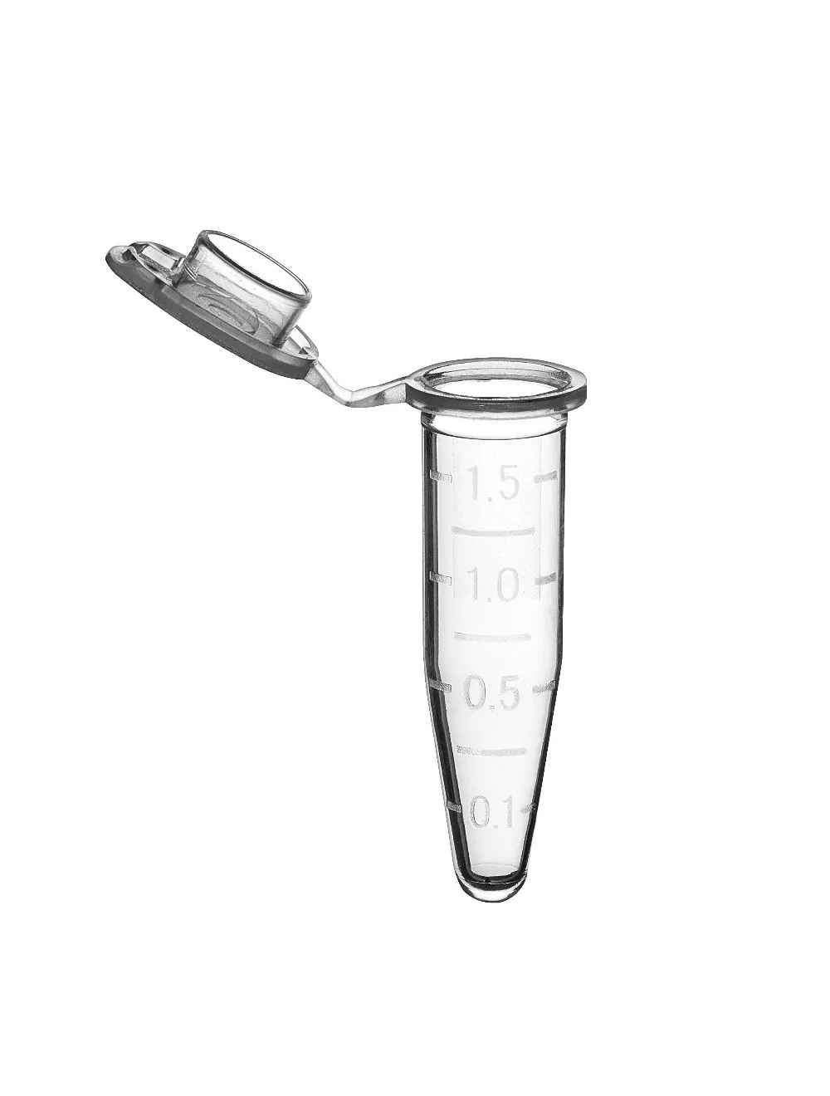
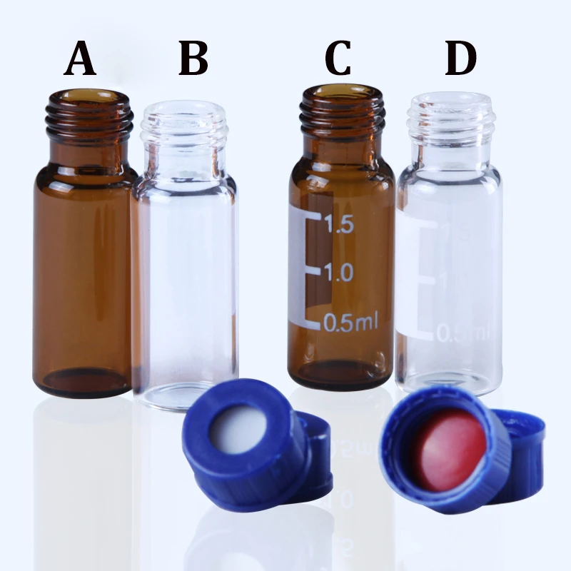
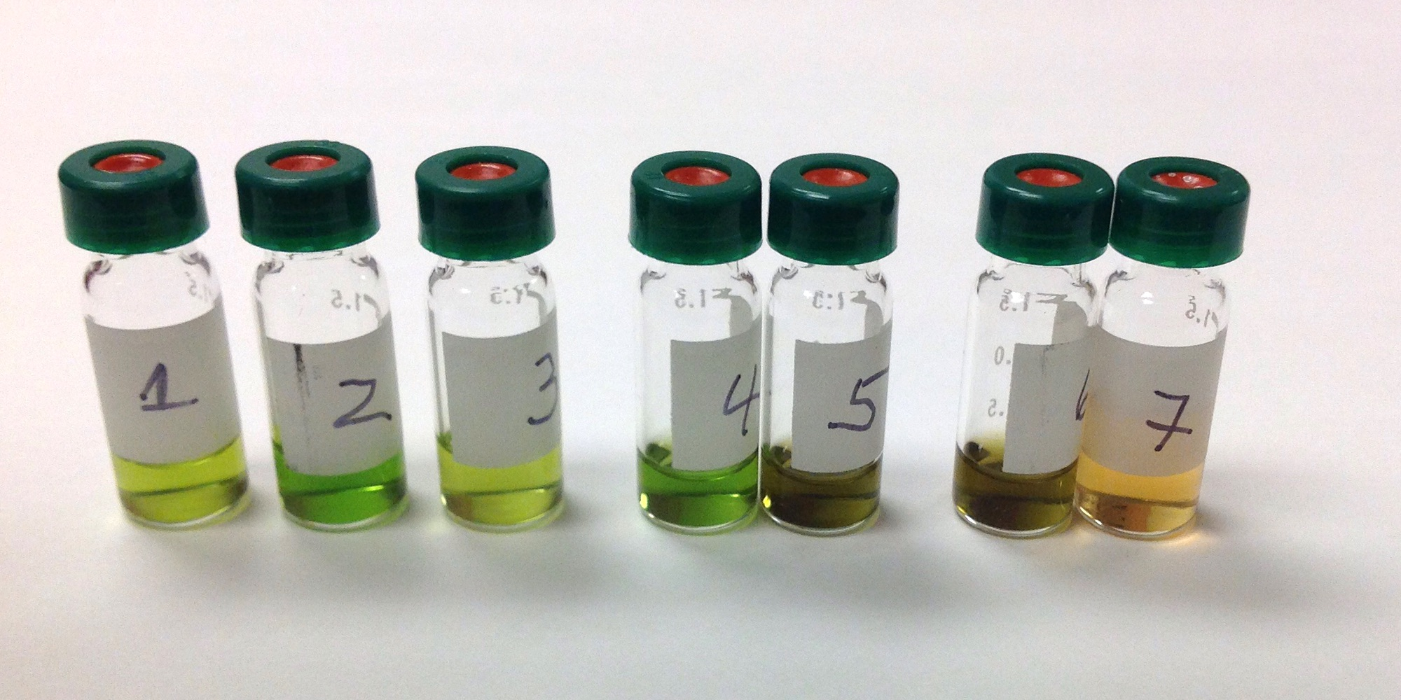
Sample Prep – Vials and Injection Vials
Colorado State University
Fort Collins, CO

Slide 16
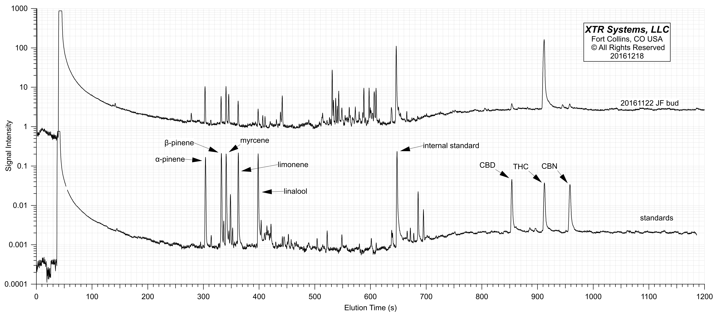
Standards and Sample
Colorado State University
Fort Collins, CO

Slide 17
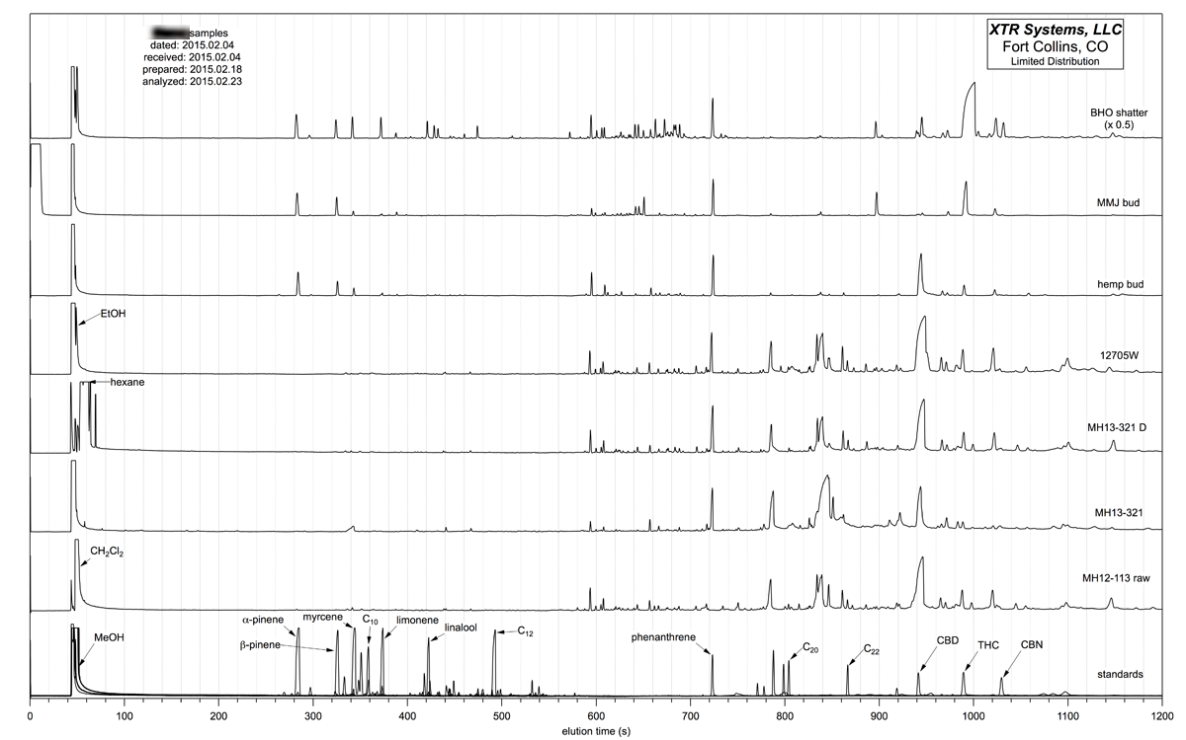
More Samples
Colorado State University
Fort Collins, CO

Slide 18
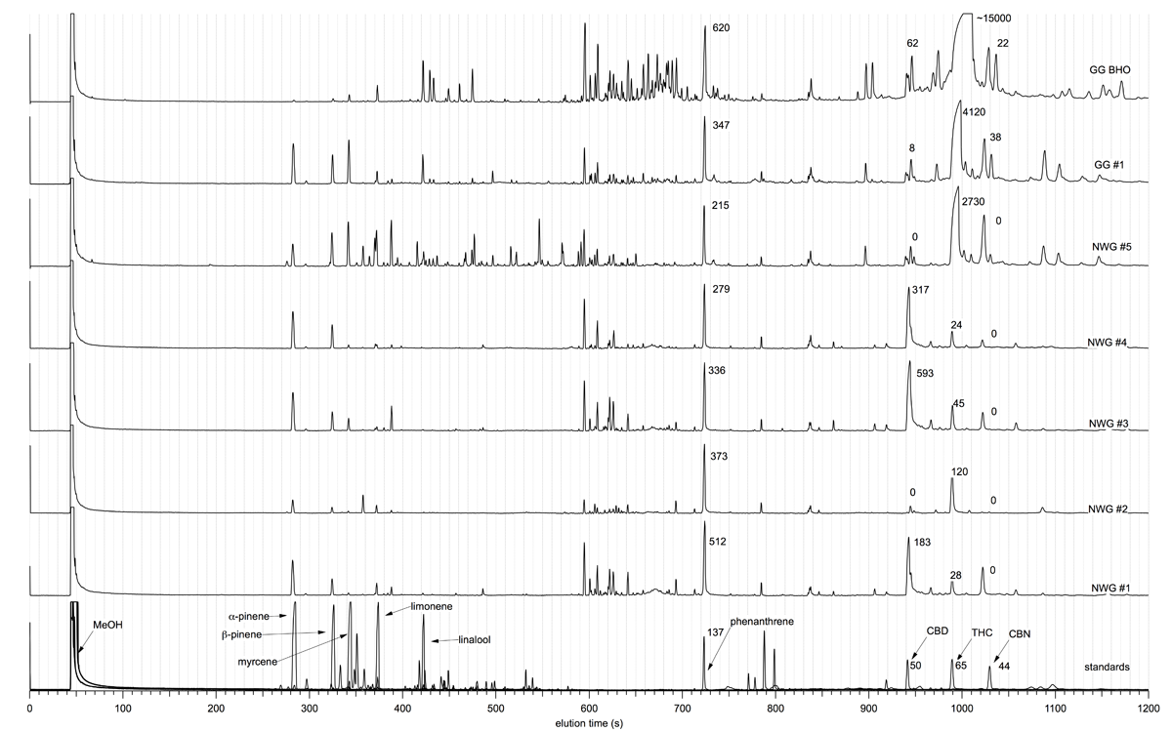
Even More Samples
Colorado State University
Fort Collins, CO

Slide 19
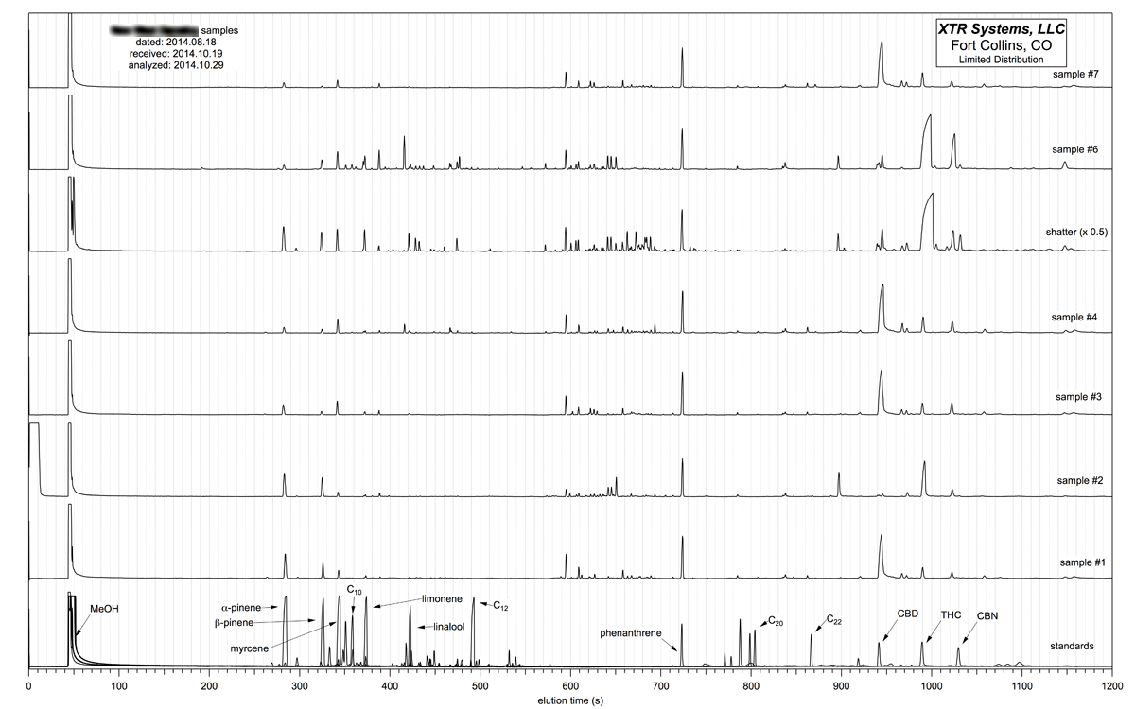
Even More Samples
Colorado State University
Fort Collins, CO

Slide 20
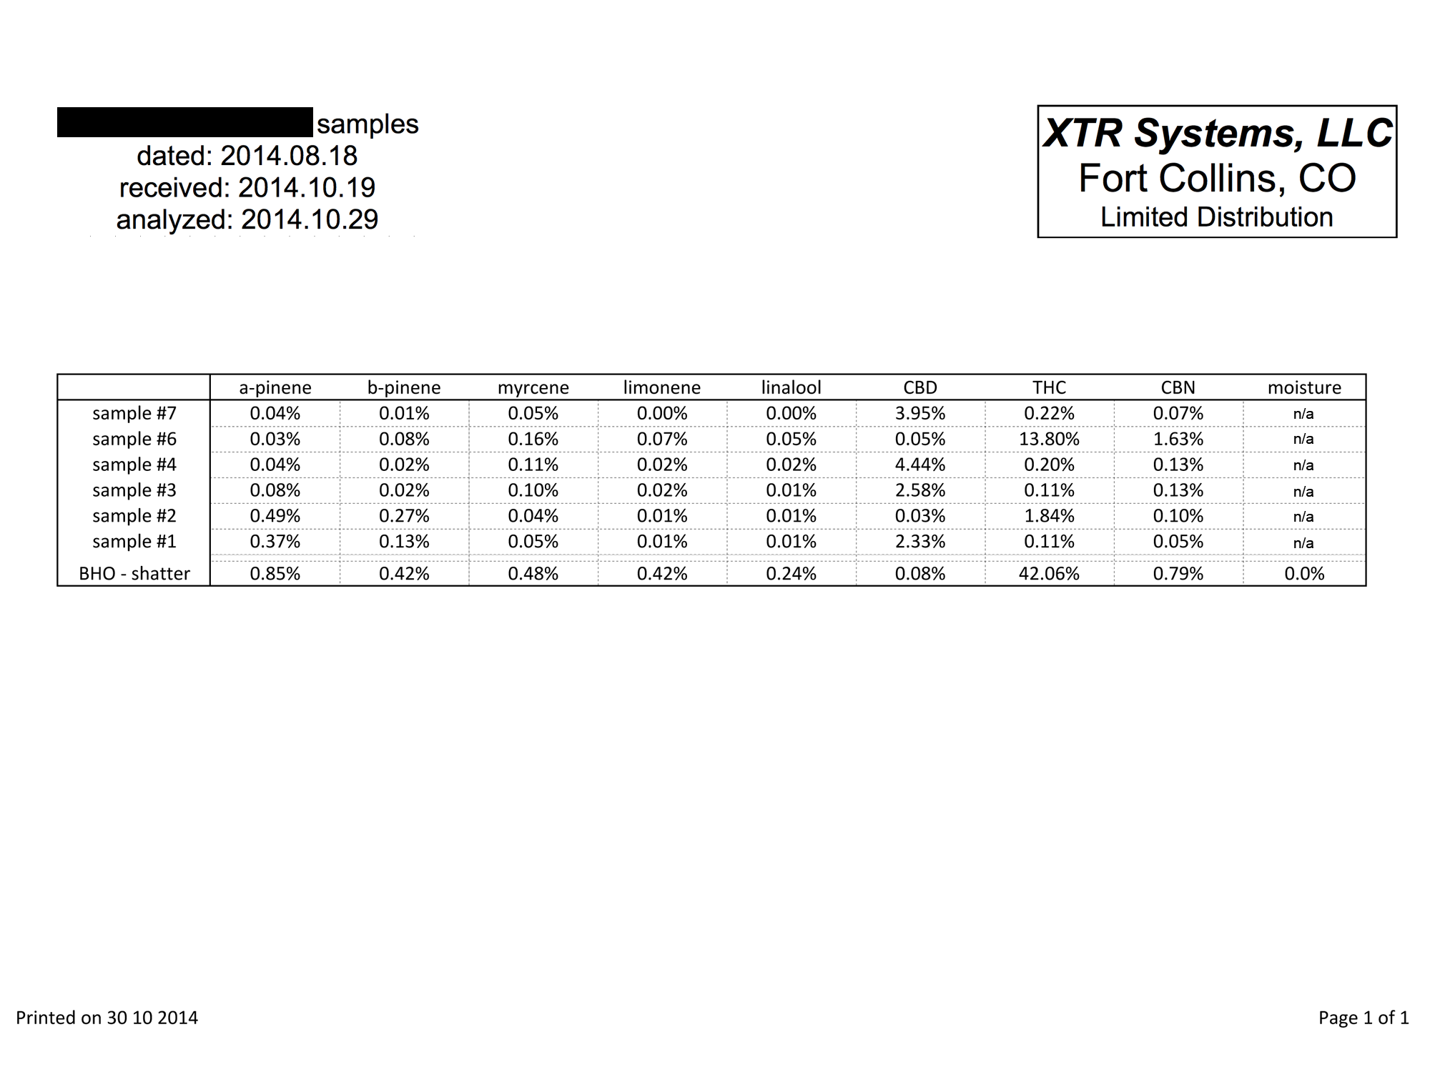
Summary Results Table
Colorado State University
Fort Collins, CO

Slide 21
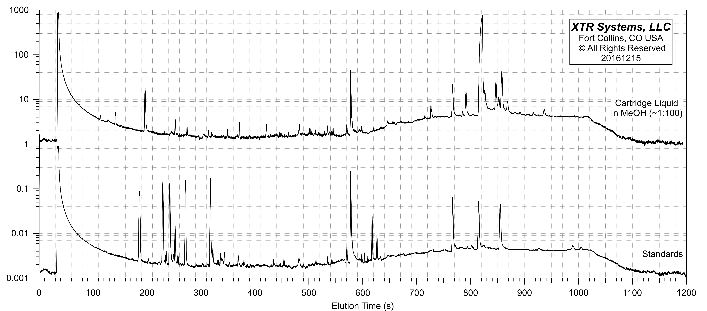
Vape Cartridge Analysis
Colorado State University
Fort Collins, CO

Slide 22
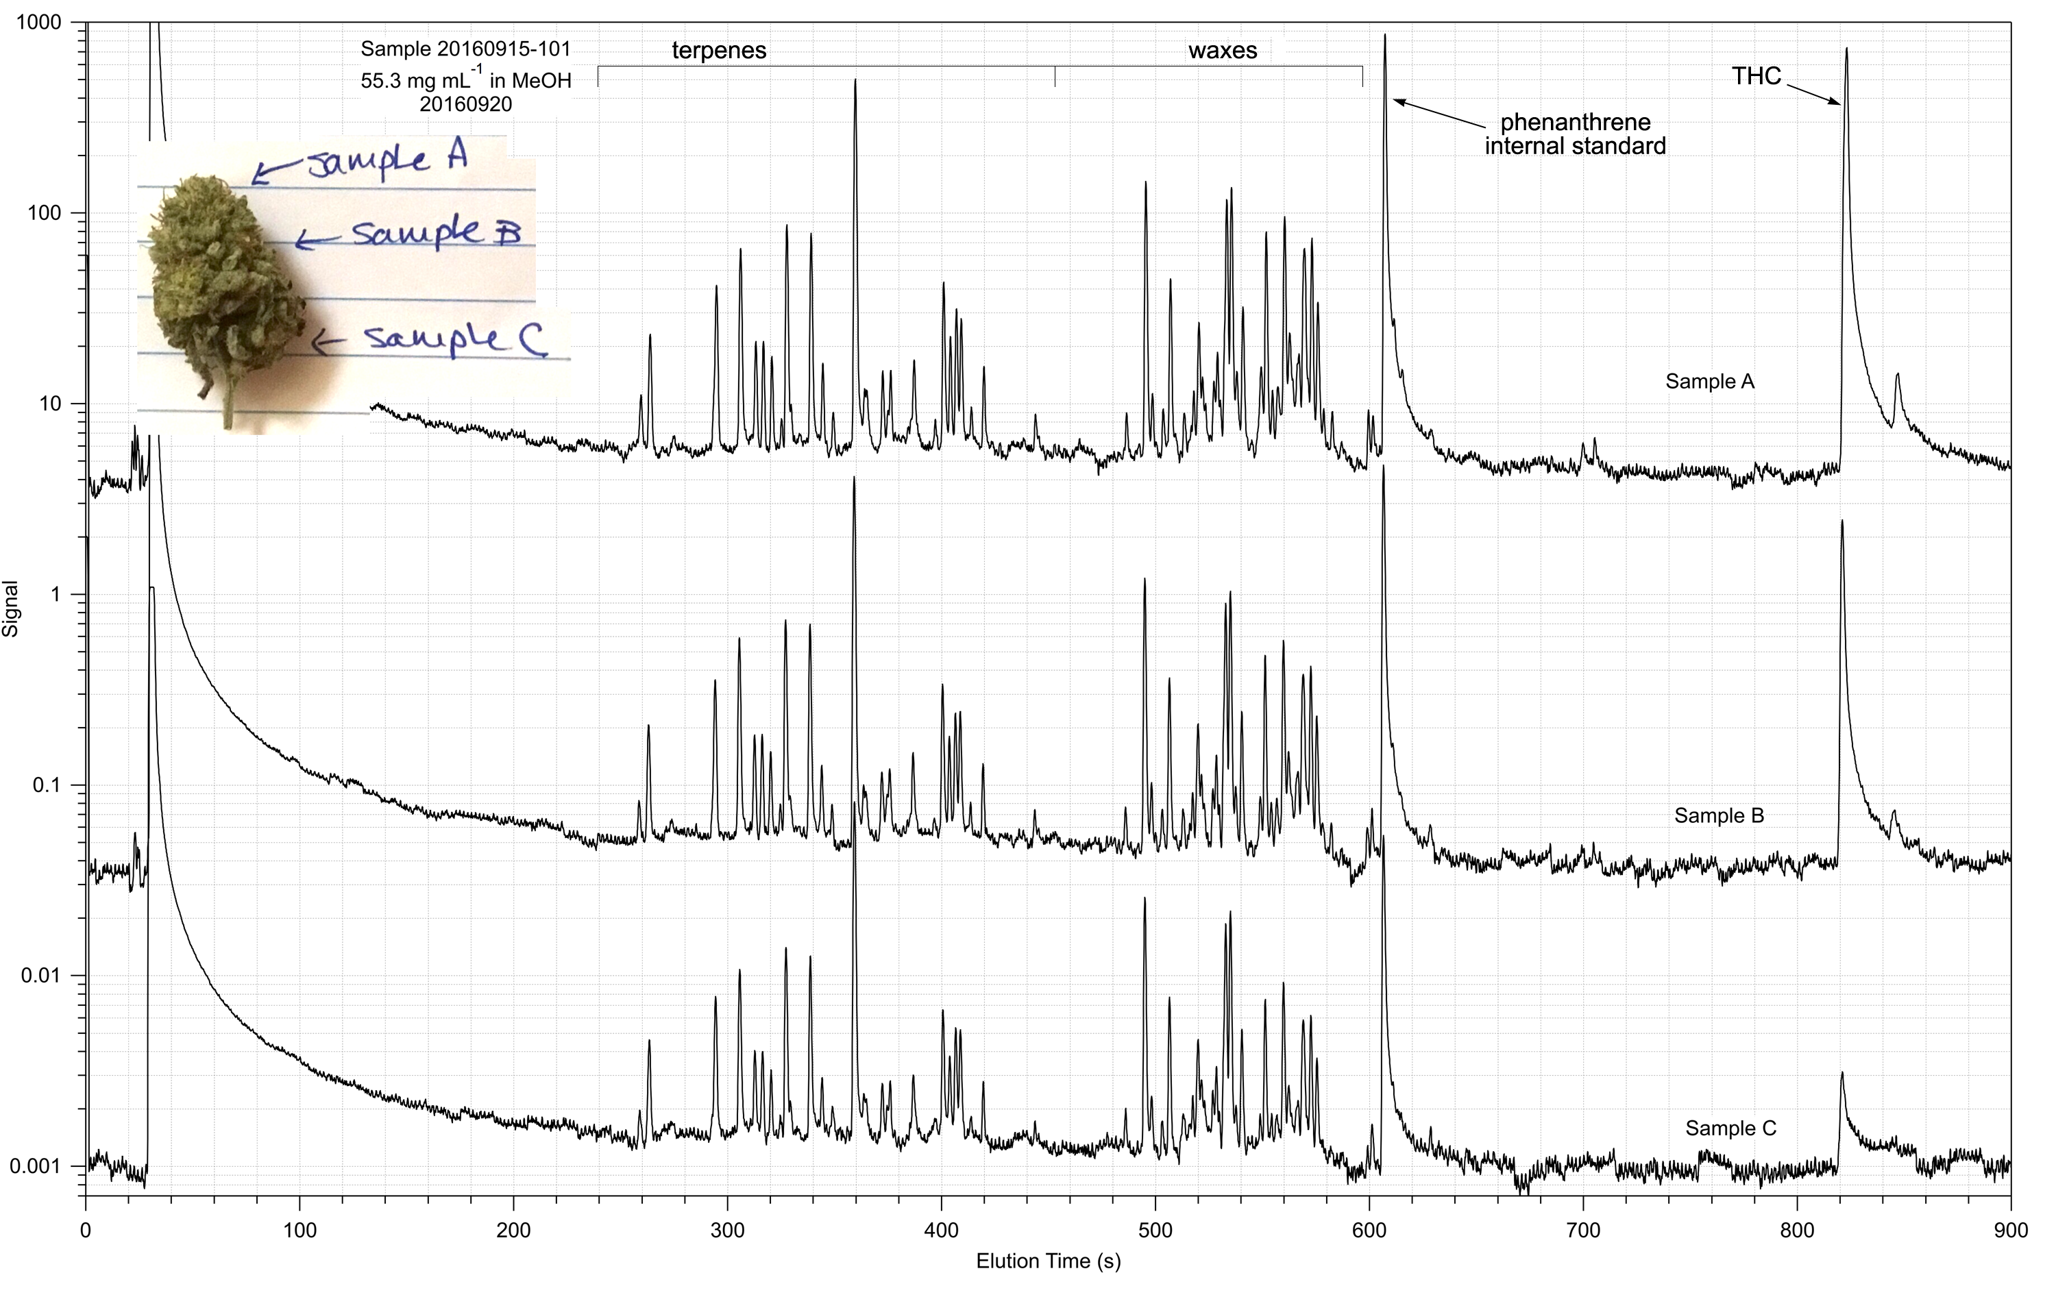
Spatial Distribution in Flower/Bud
Colorado State University
Fort Collins, CO

Slide 23
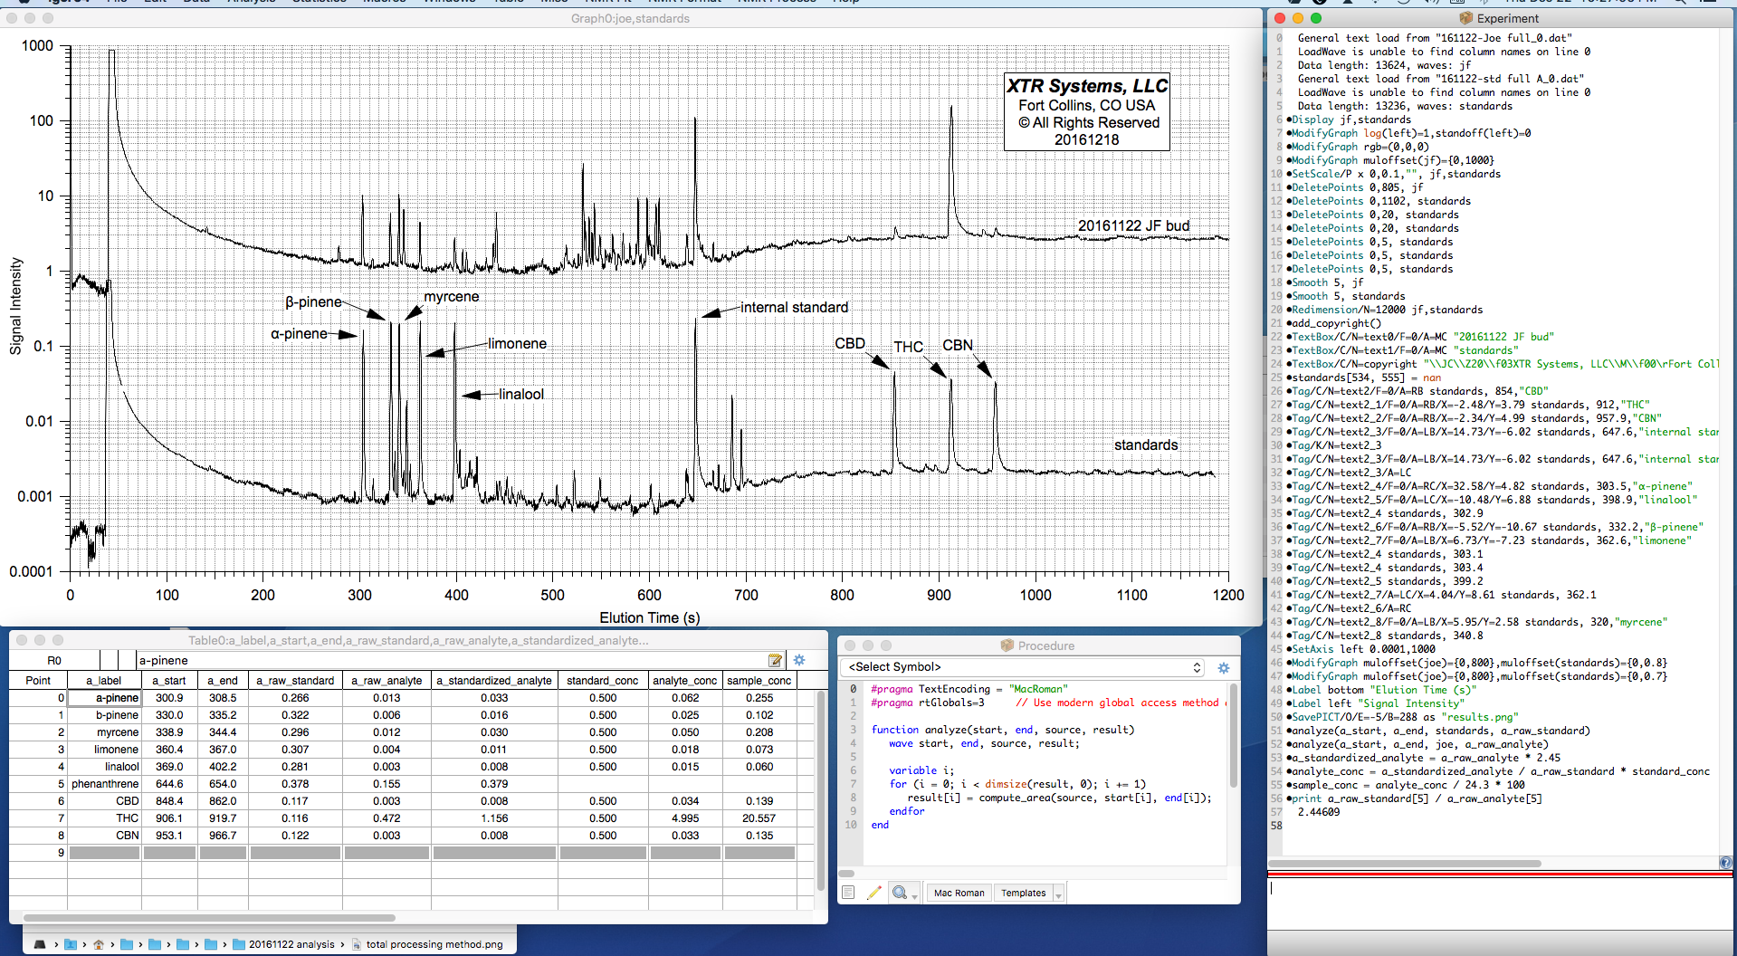
Example Rigorous Analysis
Colorado State University
Fort Collins, CO

